Slide 1
INTRODUCTION
Admission chance for pg programs of ug students:-
This dataset is created for prediction of Graduate Admissions from an Indian perspective. The dataset contains several parameters which are considered important during the application for Masters Programs.
Submitted By:- RAVI RANJAN CHAUBEY

Slide 2
BUISNESS PROBLEM & SOLUTION
BUISNESS PROBLEM :- TO PREDICT CHANCE OF GETTING ADMISSION IN COLLEGE.
BUISNESS SOLUTION:- BUILD A MACHINE LEARNING MODEL USING MULTIPLE LINEAR REGRESSION ALGORITHM IN PYTHON AND R.
CHANCE OF ADMIT IS DEPENDENT OR TARGET VARIABLE.
ALL OTHER VARIABLES SUCH AS 1. GRE Scores ( out of 340 ) 2. TOEFL Scores ( out of 120 ) 3. University Rating ( out of 5 ) 4. Statement of Purpose and Letter of Recommendation Strength ( out of 5 ) 5. Undergraduate GPA ( out of 10 ) 6. Research Experience ( either 0 or 1 ) 7 ARE INDEPENDENT VARIABLES.

Slide 3
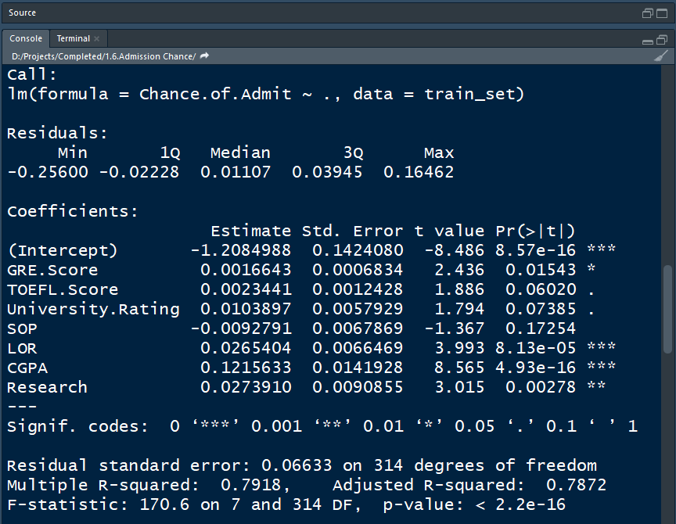
MODEL INTERPRETATION
1.P VALUE OF GRE,LOR,CGPA AND RESEARCH IS LESS THAN 0.05 SO THEY ARE SIGNIFICANT VARIABLE.
2.SLOPE OF SIGNIFICANT IND. VAR. :-
A. GRE SCORE : -1.208
B. LOR : 0.026
C. CGPA : 0.121
D. RESEARCH : 0.027
3. A) ONE UNIT INCREASE IN GRE SCORE WILL DECREASE ADMISSION CHANCE BY 1.20
B) ONE UNIT INCREASE IN LOR WILL INCREASE ADMISSION CHANCE BY 0.026
C) ONE UNIT INCREASE IN CGPA WILL INCREASE ADMISSION CHANCE BY 0.121
D) ONE UNIT INCREASE IN CGPA WILL INCREASE ADMISSION CHANCE BY 0.027

Slide 4
MODEL INTERPRETATION CONTINUE
4. A) INCREASE IN GRE SCORE WILL DECREASE CHANCE OF ADMISSION.
B) INCREASE IN LOR WILL INCREASE CHANCE OF ADMISSION
C) INCREASE IN CGPA WILL INCREASE CHANCE OF ADMISSION
D) INCREASE IN RESEARCH WILL INCREASE CHANCE OF ADMISSION
5.R SQUARED IS 0.791 WHICH MEANS 79% OF DEPENDENT DEPENDENT VARIABLE IS EXPLAINED BY INDEPENDENT VARIABLE.
6.ADJUSTED R SQUARED IS 0.782 WHICH IS LESS THAN R SQUARED.
7. WE CAN SEE THAT THERE IS MORE THAN ONE SIGNIFICANT INDEPENDENT VARIABLE SO WE WILL RERUN THE MODEL.

Slide 5
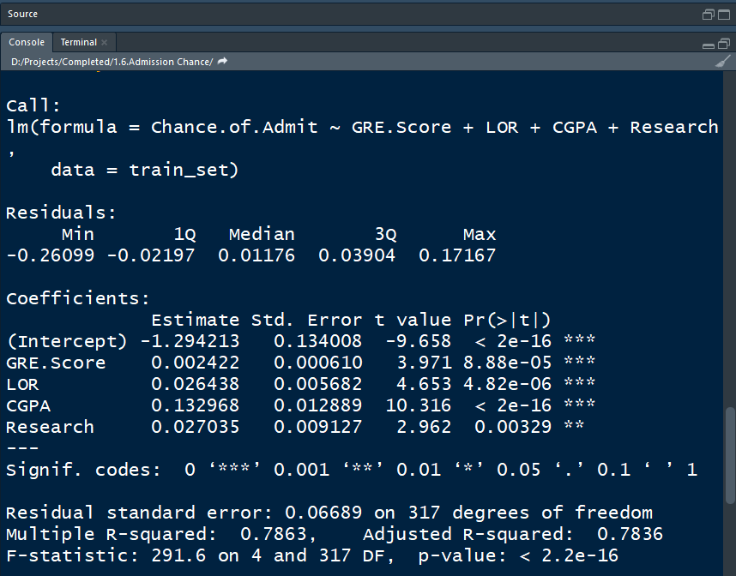
RERUN MODEL
1.P VALUE OF GRE,LOR,CGPA AND RESEARCH IS LESS THAN 0.05 SO THEY ARE SIGNIFICANT VARIABLE.
2.SLOPE OF SIGNIFICANT IND. VAR. :-
A. GRE SCORE : 0.0024
B. LOR : 0.0264
C. CGPA : 0.1329
D. RESEARCH : 0.02703
3. A) ONE UNIT INCREASE IN GRE SCORE WILL INCREASE ADMISSION CHANCE BY 0.0024
B) ONE UNIT INCREASE IN LOR WILL INCREASE ADMISSION CHANCE BY 0.0264
C) ONE UNIT INCREASE IN CGPA WILL INCREASE ADMISSION CHANCE BY 0.1329
D) ONE UNIT INCREASE IN CGPA WILL INCREASE ADMISSION CHANCE BY 0.02703

Slide 6
MODEL INTERPRETATION CONTINUE
4. A) INCREASE IN GRE SCORE WILL INCREASE CHANCE OF ADMISSION.
B) INCREASE IN LOR WILL INCREASE CHANCE OF ADMISSION
C) INCREASE IN CGPA WILL INCREASE CHANCE OF ADMISSION
D) INCREASE IN RESEARCH WILL INCREASE CHANCE OF ADMISSION
5.R SQUARED IS 0.786 WHICH MEANS 78% OF DEPENDENT DEPENDENT VARIABLE IS EXPLAINED BY INDEPENDENT VARIABLE.
6.ADJUSTED R SQUARED IS 0.783 WHICH IS LESS THAN R SQUARED.

Slide 7
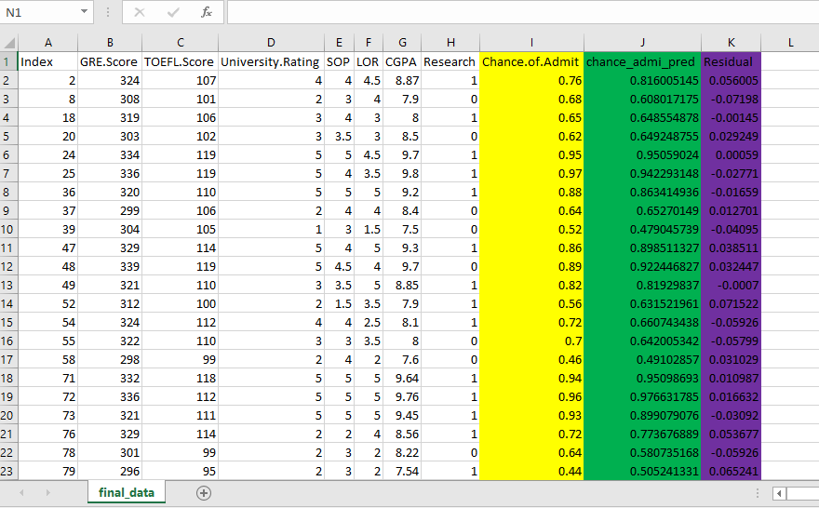
CONCLUSION
WE CAN SEE THAT RESIDUALS ARE LOW, SO THIS MODEL IS PERFORMING VERY GOOD.
YOU CAN FIND THE EXCEL SHEET BELOW.

